Slide 1
Live Tiles, Push Notifications and Action Center Developer’s Guide to Windows 10

Slide 2
Agenda
Tile basics
Tile templates
Adaptive templates
Toast
Interactive toast
Push Notifications
Action Center

Slide 3
Tile basics

Slide 4
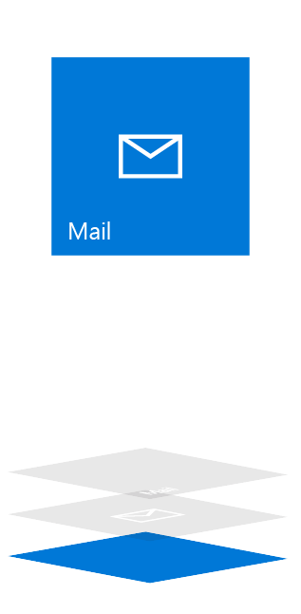
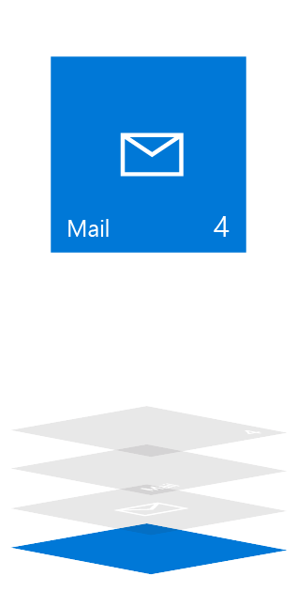
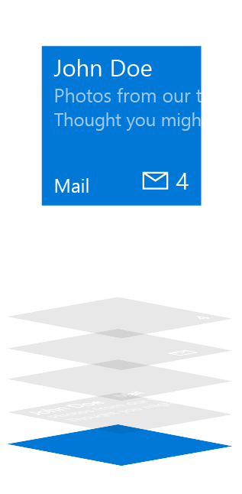
Tile anatomy
Basic State
Semi-Live State
Live State
Plate
Plate
Plate
Content
App Logo
App Logo
App Icon
Badge
Badge
Short Name
Short Name
Short Name
Badge
Badge
App Icon
Short Name
Short Name
Short Name
App Logo
App Logo
Content
Plate
Plate
Plate

Slide 5
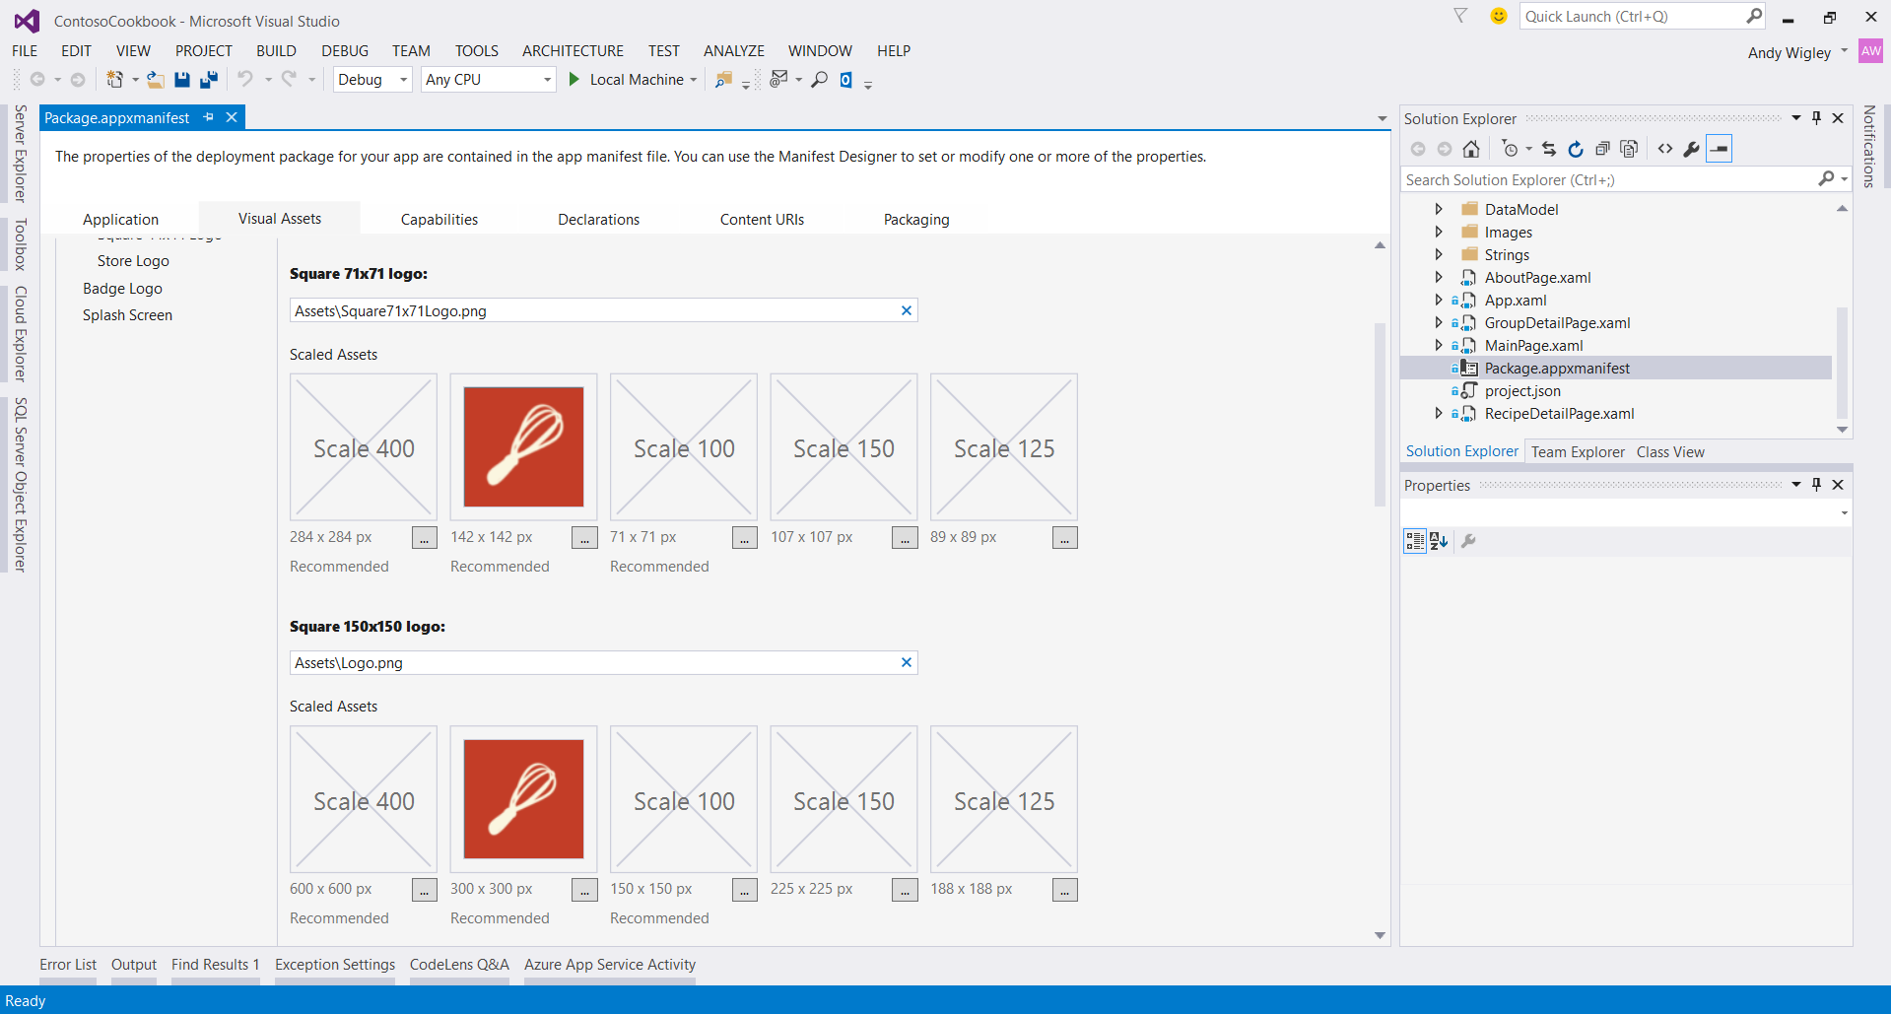
Primary Tile

Slide 6
Updating tiles
Scheduled
Set template and time with “ScheduledTileNotification”
Periodic
Pull from URL 30m / 60m / 6h / 12h / 24h
Local
Update from (foreground/background) app
Push
Use push services
Update badge

Slide 7
Update tile badge
// build badge
var type = BadgeTemplateType.BadgeNumber;
var xml = BadgeUpdateManager.GetTemplateContent(type);
// update element
var elements = xml.GetElementsByTagName("badge");
var element = elements[0] as Windows.Data.Xml.Dom.XmlElement;
element.SetAttribute("value", "47");
// send to lock screen
var updator = BadgeUpdateManager.CreateBadgeUpdaterForApplication();
var notification = new BadgeNotification(xml);
updator.Update(notification);

Slide 8
Create a secondary tile
var tileId = "DetailsTile";
var pinned = SecondaryTile.Exists(tileId);
if (!pinned)
{
var tile = new SecondaryTile(tileId)
{
DisplayName = "Record details",
Arguments = "123"
};
// extra details
var success = await tile.RequestCreateAsync();
}

Slide 9
Tile templates

Slide 10
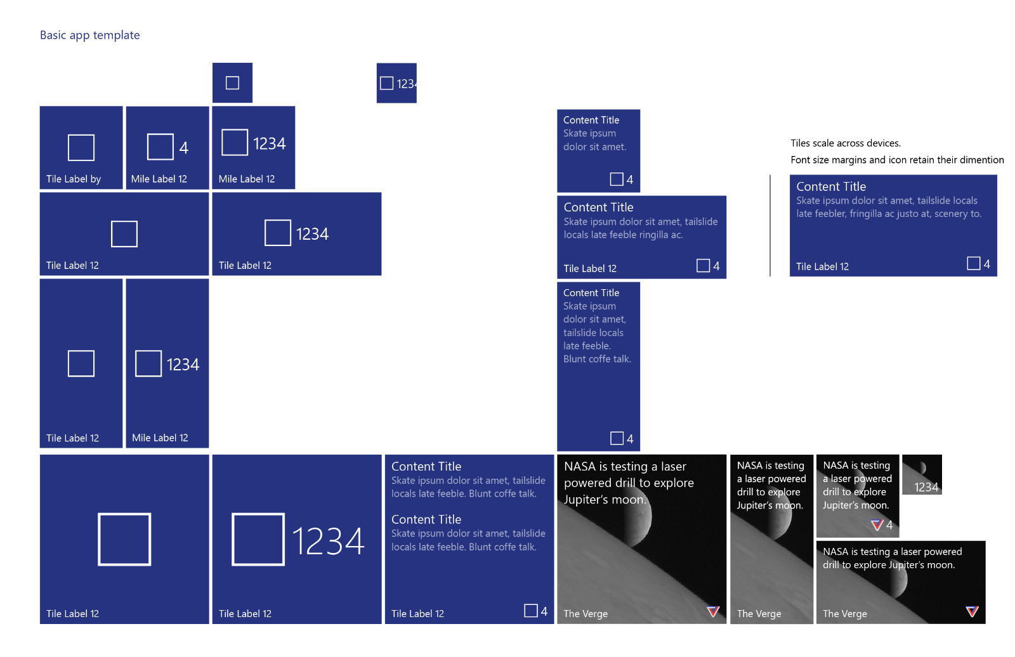

Slide 11
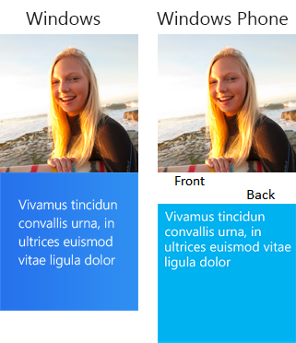
Legacy templates
If a template meets your needs, go ahead and use it.
Previous templates remain
Phone and Windows templates have been merged
There are over 80 templates available

Slide 12
Please don’t say more templates.

Slide 13
Adaptive templates

Slide 14
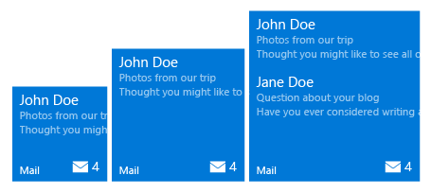
Adaptive tiles
<tile>
<visual>
<binding template="TileMedium">
<group> <subgroup>
<text hint-style="subtitle">John Doe</text>
<text hint-style="subtle">Photos from our trip</text>
<text hint-style="subtle">Thought you might…</text>
</subgroup>
</group>
<group> <subgroup>
…
</subgroup>
</group>
</binding>
</visual>
</tile>
Min. Med Size
Max Med. Size

Slide 15
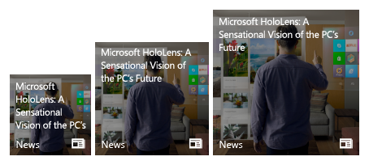
Adaptive tiles
<tile>
<visual>
<binding template="TileMedium">
<image source="Assets\image.png" placement="background" />
<text hint-wrap="true">
Microsoft HoloLens: A
Sensational Vision of the PC’s Future
</text>
</binding>
</visual>
</tile>
Min. Med Size
Max Med. Size

Slide 16
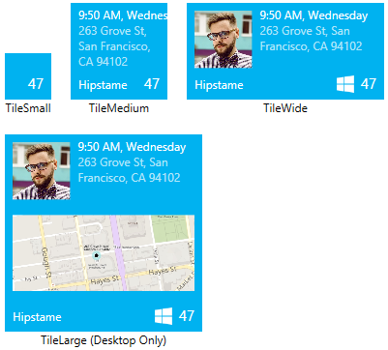
Sample: Small Tile
<binding template="TileSmall"
branding="none" hint-textStacking="center">
</binding>

Slide 17
Sample: Medium Tile
<binding template="TileMedium"
branding="Name" displayName="Hipstame">
<text hint-style="caption">
9:50 AM, Wednesday</text>
<text hint-style="captionsubtle" hint-wrap="true">
263 Grove St, San Francisco, CA 94102</text>
</binding>

Slide 18
Sample: Wide Tile
<binding template="TileWide" displayName="Hipstame">
<group>
<subgroup hint-weight="33">
<image placement="inline" src="http://image.jpg" />
</subgroup>
<subgroup>
<text hint-style="caption">
9:50 AM, Wednesday</text>
<text hint-style="captionsubtle"
hint-wrap="true" hint-maxLines="3">
263 Grove St, San Francisco, CA 94102</text>
</subgroup>
</group>
</binding>

Slide 19
Sample: Large Tile
<binding template="TileLarge" displayName="Hipstame">
<group>
<subgroup hint-weight="33">
<image placement="inline" src="http://image.jpg" />
</subgroup>
<subgroup>
<text hint-style="caption">
9:50 AM, Wednesday</text>
<text hint-style="captionsubtle"
hint-wrap="true" hint-maxLines="3">
263 Grove St, San Francisco, CA 94102</text>
</subgroup>
</group>
<image placement="inline" src="http://map.jpg"/>
</binding>

Slide 20
Toast

Slide 21
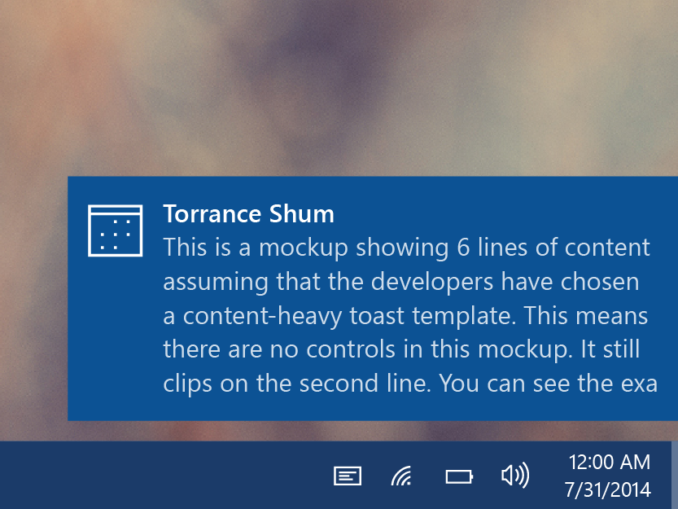
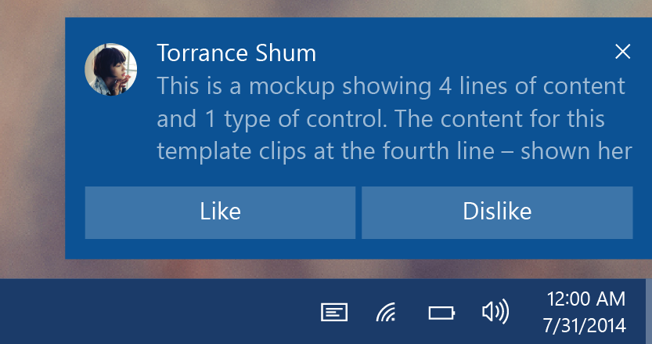
Toasts
Glance (consume)
See new information from your apps.
Act (chase, or take actions)
Toasts invite you to begin or complete a task.
The toast is the app’s door by chasing (clicking) it.
Additional actions enable users to perform simple tasks without context switching.

Slide 22
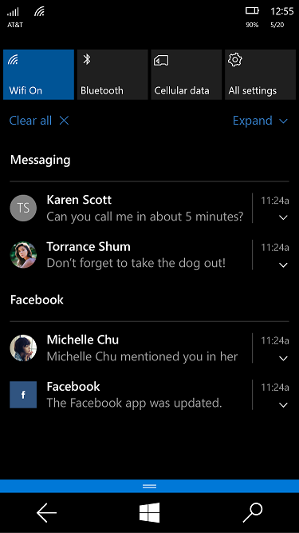
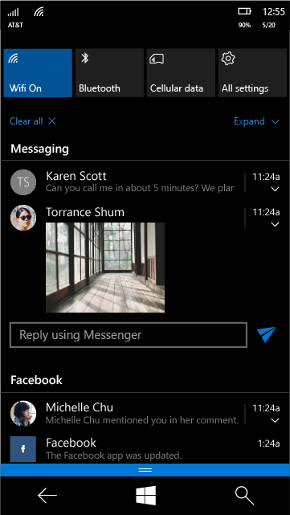
Toast states
Collapsed state
Action center chevron
Mobile default
Expanded state
Action center chevron
Desktop default

Slide 23
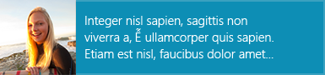
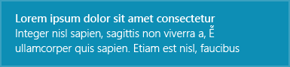
Toast templates
If a template meets your needs, go ahead and use it.
Previous templates remain
Phone and Windows templates have been merged
Adaptive template
Same XML syntax as tiles

Slide 24
Sending toast
Scheduled
Set template and time with “ScheduledToastNotification”
Toast can also be set to be recurring.
Local
Send from (foreground/background) app
This includes desktop apps with “AppUserModelID”
Push
Use push services

Slide 25
Sending toast
// build toast
var template = ToastTemplateType.ToastText01;
var xml = ToastNotificationManager.GetTemplateContent(template);
xml.DocumentElement.SetAttribute("launch", "Args");
// set value
var text = xml.CreateTextNode(content);
var elements = xml.GetElementsByTagName("text");
elements[0].AppendChild(text);
// show toast
var toast = new ToastNotification(xml);
var notifier = ToastNotificationManager.CreateToastNotifier();
notifier.Show(toast);

Slide 26
Sending toast
// build toast
toast = new ToastNotification(toastXml);
toast.Tag = tag;
toast.Group = group;
// show toast
var notifier = ToastNotificationManager.CreateToastNotifier();
notifier.Show(toast);

Slide 27
Handling activation
void OnActivated(IActivatedEventArgs args)
void OnLaunched(LaunchActivatedEventArgs args)
if (args.Kind == ActivationKind.Launch
&& args.Arguments == null && args.TileId != "App") { /* handle primary tile (or toast) */ }

Slide 28
Interactive toast

Slide 29
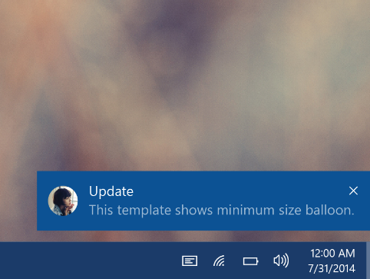
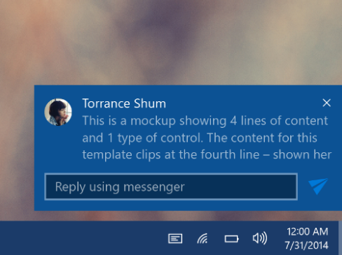
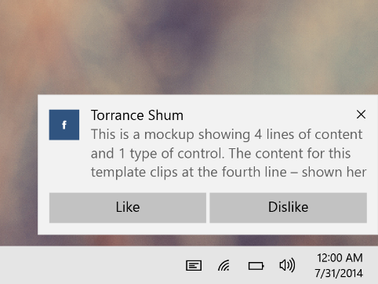
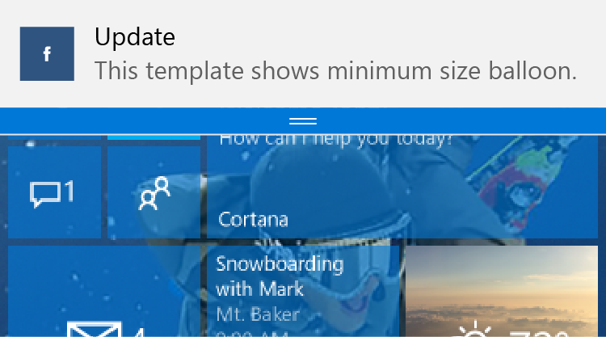
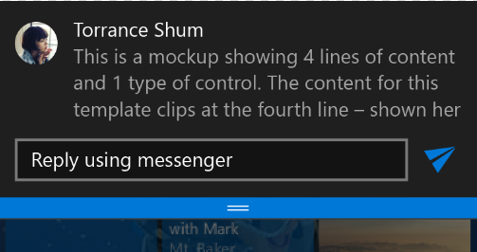
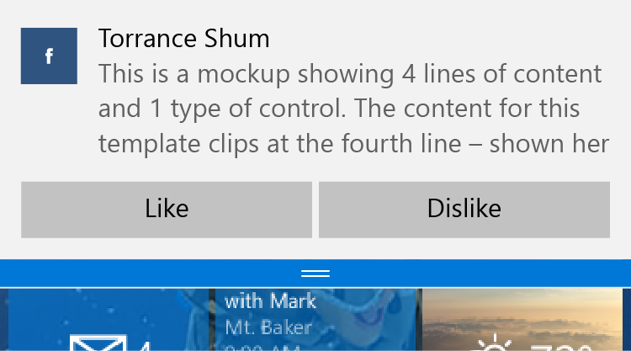
Interactive toast
Desktop
Mobile

Slide 30
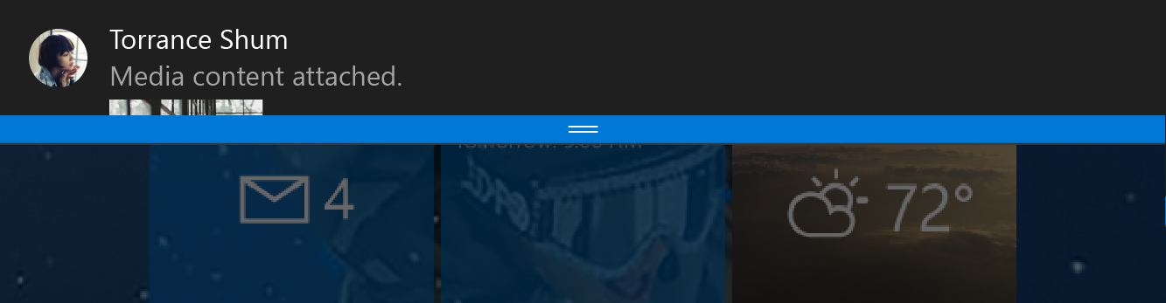
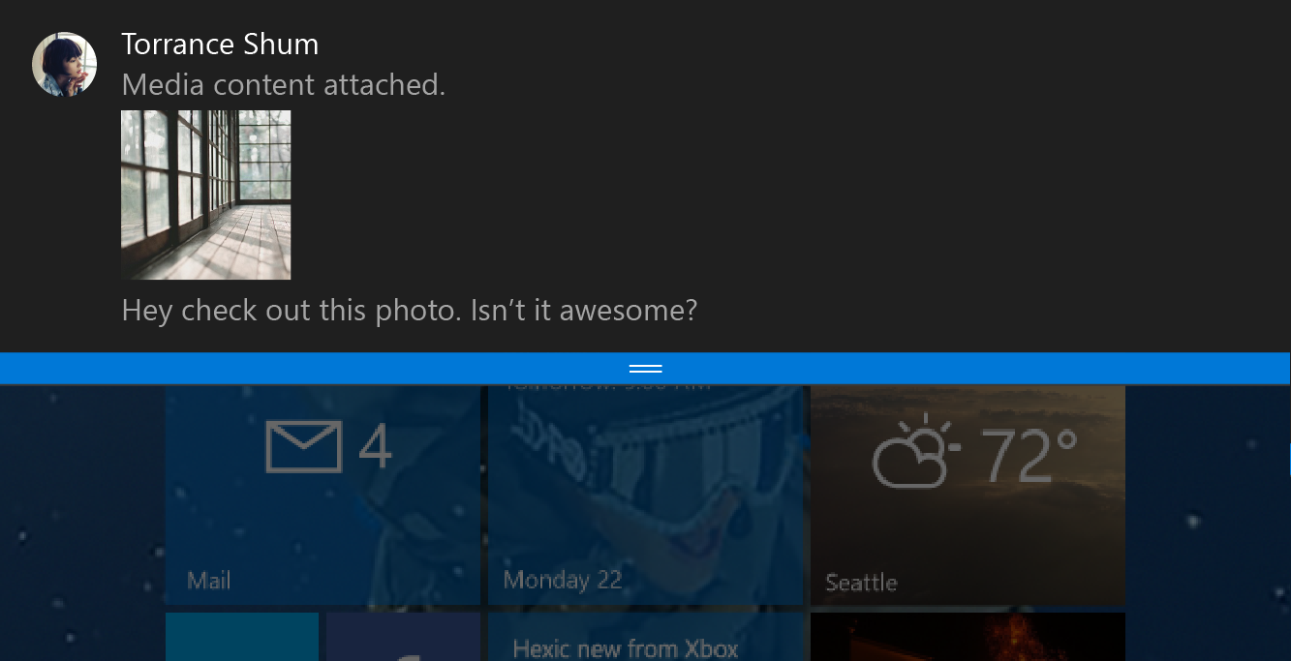
Toast notifications
<toast>
<visual>
<binding template="ToastGeneric">
<image placement="appLogoOverride"
src="Torrance Shum.png" />
<text>Torrance Shum</text>
<text>Media content attached.</text>
<image placement="inline"
src="attachment.png" />
<text>Hey check out this photo.
Isn’t it awesome?</text>
</binding>
</visual>
</toast>

Slide 31
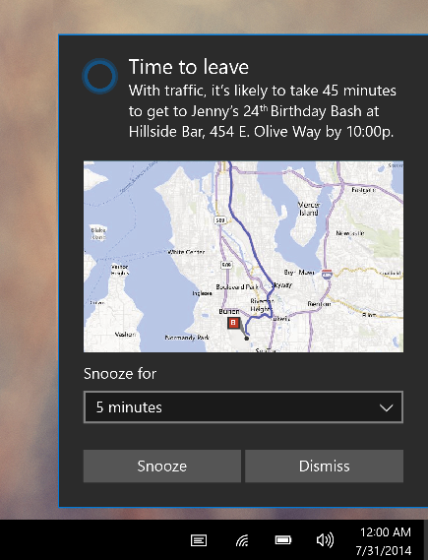
Toast input
<toast>
...
<actions>
<input title="Snooze for" id="snoozeTime"
type="selections" defaultSelection="5">
<selection id="5" content="5 minutes" />
<selection id="10" content="10 minutes" />
<selection id="20" content="20 minutes" />
</input>
...
</actions>
</toast>

Slide 32
Toast action
<toast>
...
<actions>
...
<action activationType="system" arguments="snooze" hint-inputId="snoozeTime" content=""/>
<action activationType="system" arguments="dismiss" content=""/>
</actions>
</toast>

Slide 33
Toast customization
<toast>
...
<image placement="appLogoOverride" src="Logo.png" />
...
<actions>
...
<action activationType="background"
arguments="dismiss"
imageUri="send.png"
hint-inputId="1" />
</actions>
</toast>

Slide 34
New activation types & activations
<action activationType="foreground" />
<action activationType="background" />
<action activationType="protocol" />
<action activationType="system" />
Tap button
App launches
Retrieve Args
Take actions
Tap button
Task launches
Retrieve Args
Take actions
Tap button
Protocol activates
Web / app
Tap button
System handles

Slide 35
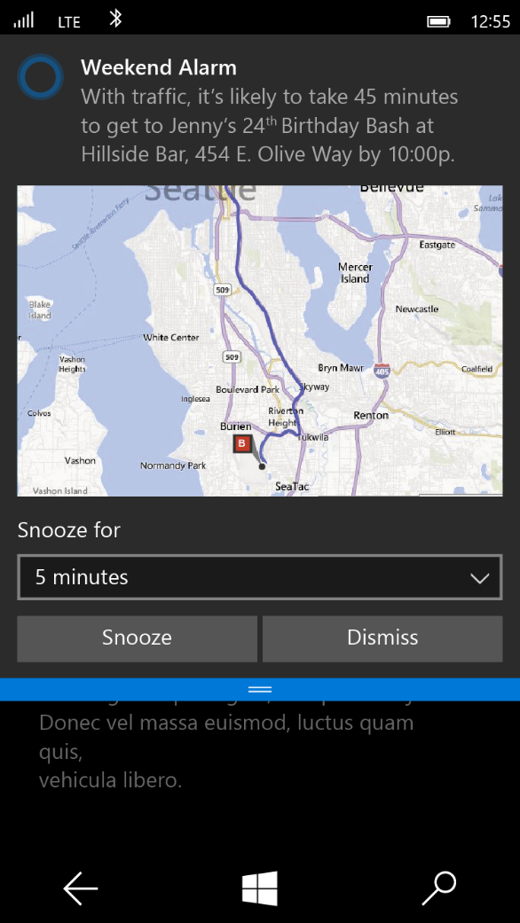
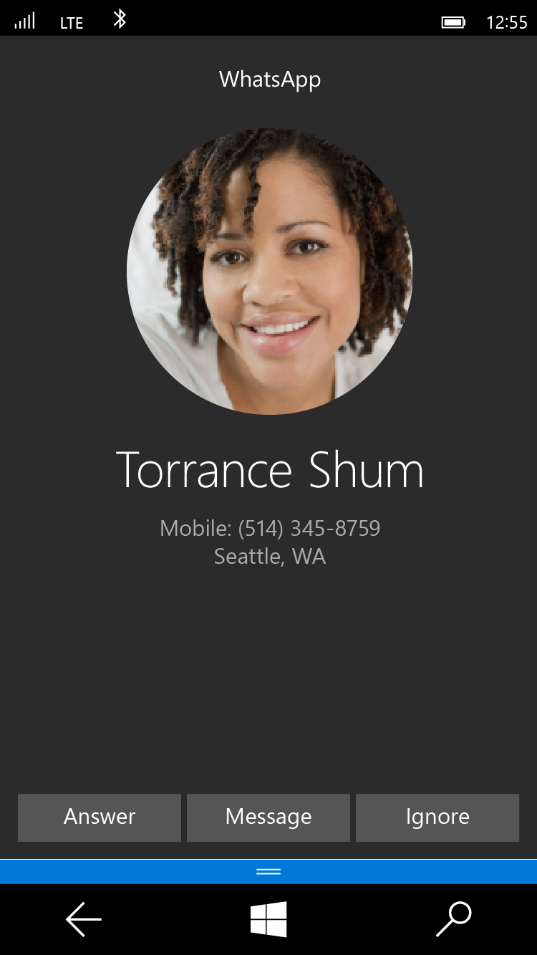
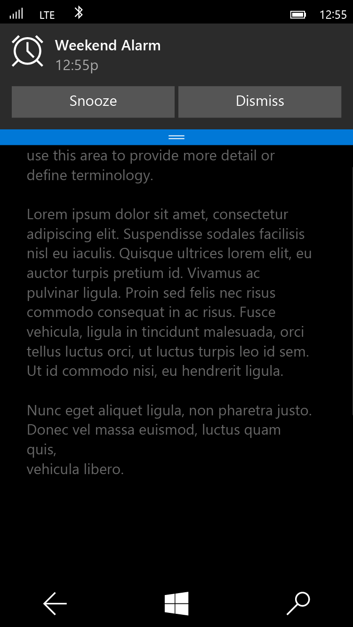
Special Toast Scenarios
Alarm
<toast scenario="alarm"...>
Reminder
<toast scenario="reminder"...>
Incoming Call
<toast scenario="incomingCall"...>

Slide 36
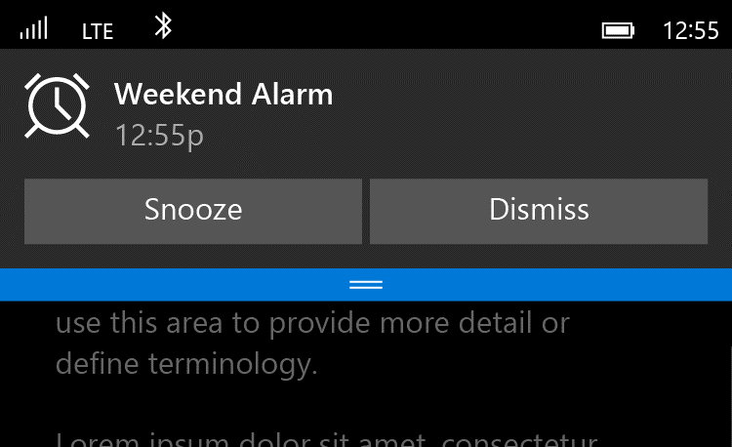
Alarms are Toasts
<toast scenario="alarm"...>
<visual>
...
</visual>
<actions>
<action activationType='system' arguments='snooze' content='' />
<action activationType='system' arguments='dismiss' content=''/>
</actions>
</toast>

Slide 37
Demo: Interactive Toast

Slide 38
Push Notifications

Slide 39
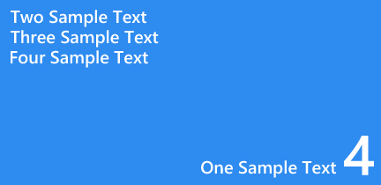
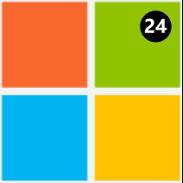
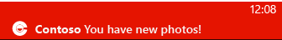
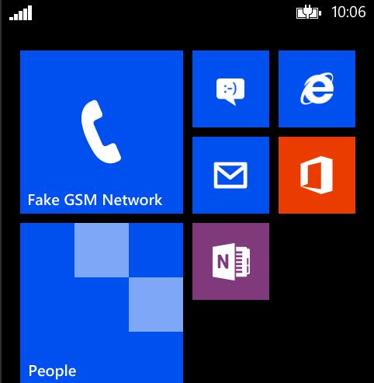
Notifications
Lots of ways to make use of notifications
Raw
(background task)
Tile
Badge
Toast
{app-specific data}

Slide 40
Windows Notification Service
One service across Windows devices
One process to register an app for push
One tile template to push to Windows & Phone apps

Slide 41
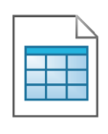
WNS – Push Architecture
Windows
My Developer Service
My Windows App
2
Request Channel URI
Register with your Cloud Service
Authenticate & Push Notification
3
1
Windows Push Notification Service
Windows Notification
Client Platform
3

Slide 42
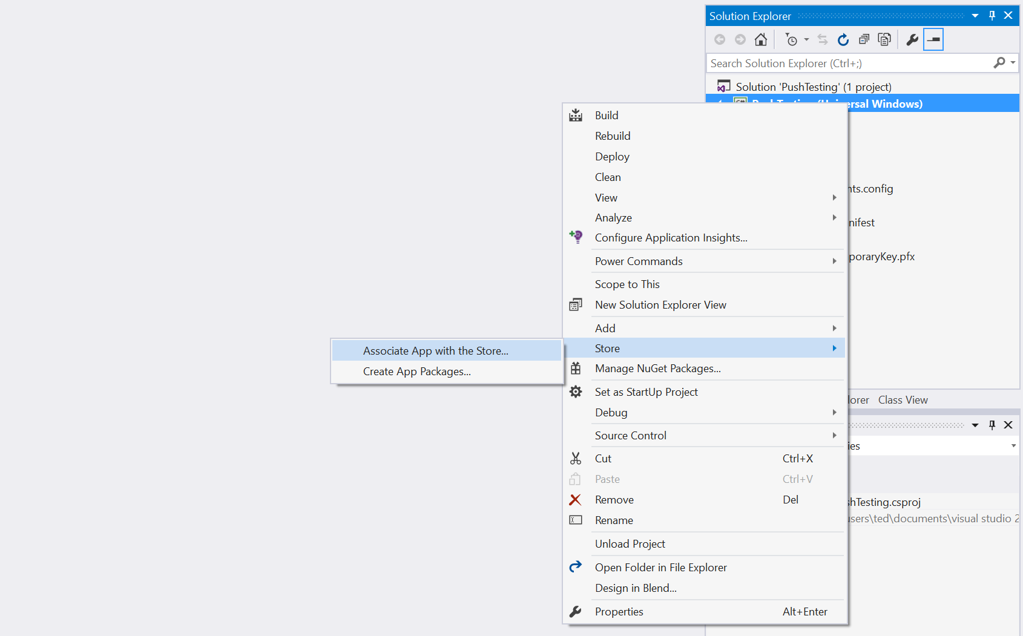
Setting Up An App For Push (Visual Studio)

Slide 43
Getting a Push Notification Channel
Get Channel URL
var channel = await
PushNotificationChannelManager.CreatePushNotificationChannelForApplicationAsync();
SaveUriForNotificationService(channel.Uri);
channel.PushNotificationReceived +=channel_PushNotificationReceived;
void gotNotification(PushNotificationChannel sender, PushNotificationReceivedEventArgs args)
{
Debug.WriteLine(args.NotificationType.ToString());
}

Slide 44
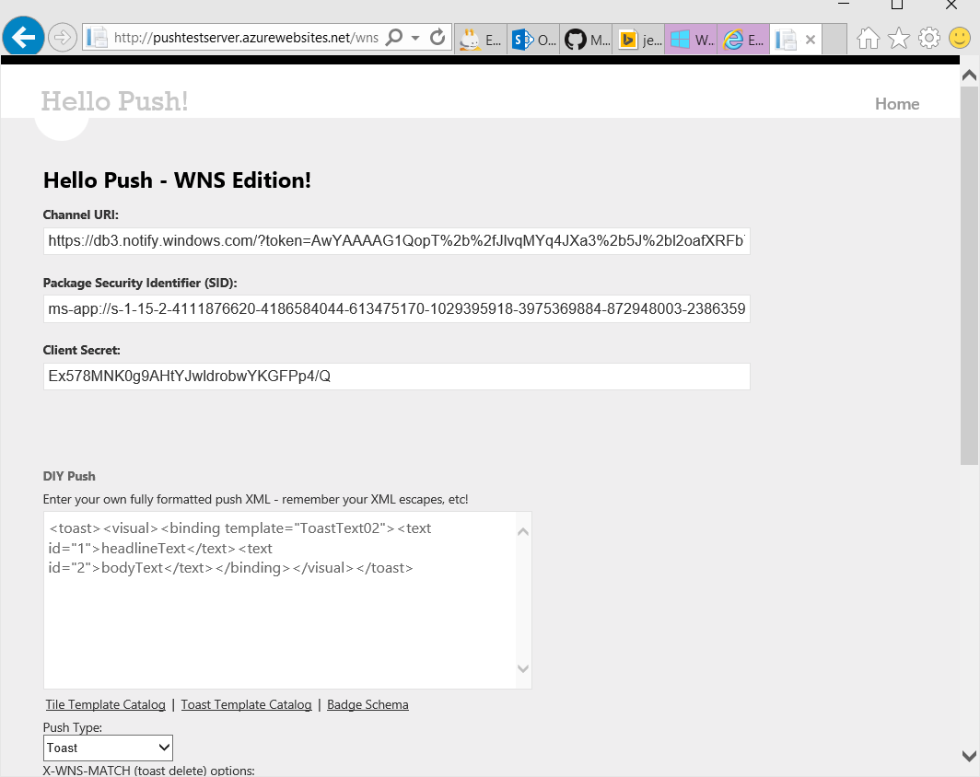
Testing Push Notifications
Sample Azure Web app for Push Notifications:
Website: http://pushtestserver.azurewebsites.net/wns/
Code: https://code.msdn.microsoft.com/windowsazure/WNS-for-Windows-and-83fd21f6

Slide 45
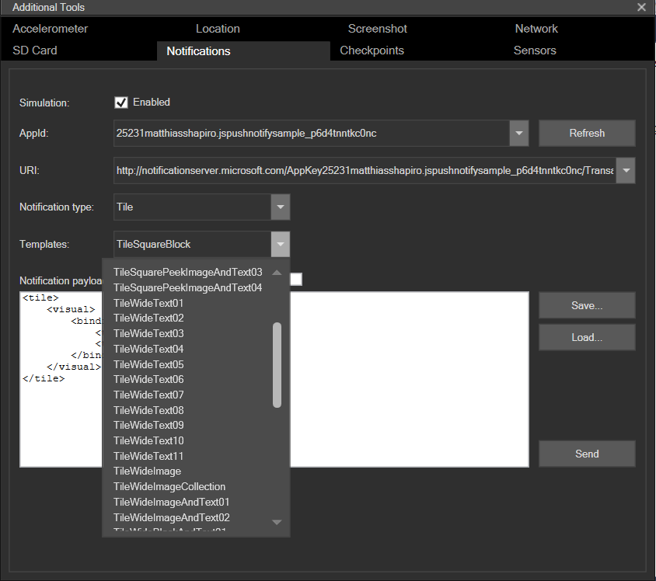
Notifications Simulation Engine

Slide 46
Push Notifications
demo

Slide 47
Push payloads
All the same notifications that you can send locally from within your app
Tile
Toast
Badge
Raw
All the same templates
‘Traditional’ templates from the template catalog
New flexible templates

Slide 48
Action Center managing your notification space

Slide 49
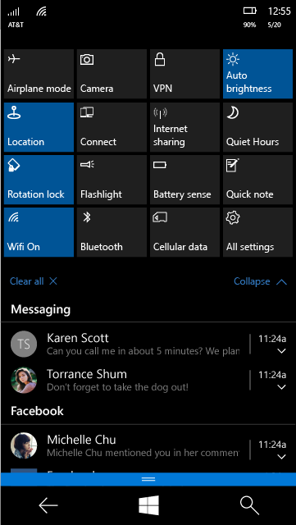
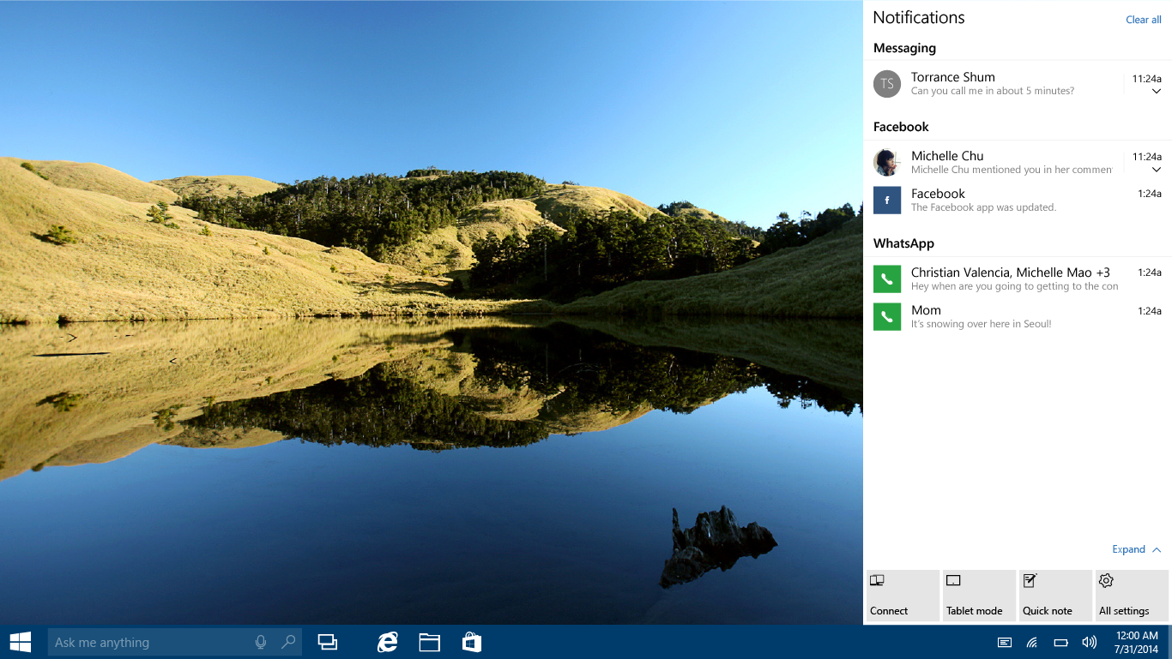
Action center & Quick actions

Slide 50
Action Center Management APIs
Manage app notifications
Developers can:
Remove one or many notifications
Tag and group notifications
Replace a notification with a new one
Set an expiration on notifications
Send “Ghost Toast” notifications (only show up in the notification center)
ToastNotificationHistory tnh = ToastNotificationManager.History;
tnh.Remove("Windows 10 Toast #1");
tnh.RemoveGroup("JumpStart");

Slide 51
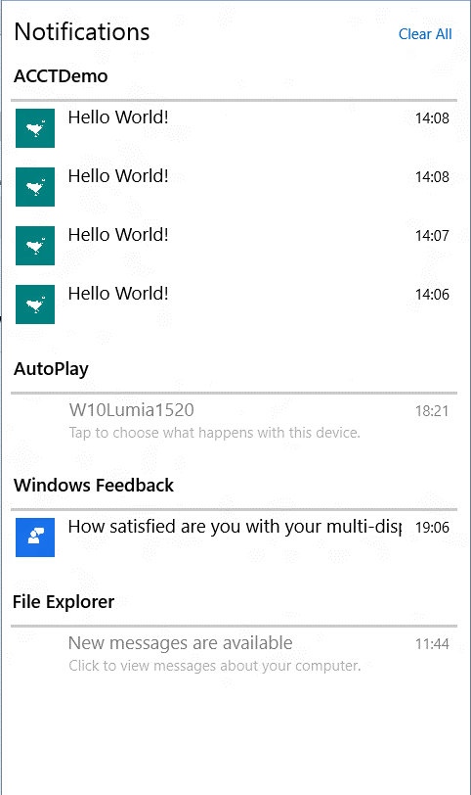
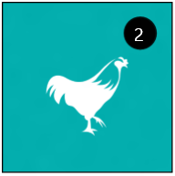
Apps’ Responsibilities on Notifications
Apps can inform user of ‘unread’ items in different ways
Count on a tile
Listed in Action Center
App + Action Center + Tile(s) must tell a consistent story for good user experience
User taps on toast popup or in Action Center -> App opens at corresponding item?
User opens app and reads unread items -> Notification in Action Center removed?
User dismisses Action Center notification -> Tile Badge count changes?

Slide 52
App, Action Center and Tile must tell a consistent story

Slide 53
Action Center change triggers
ToastNotificationHistoryChangedTrigger
Fires whenever a user dismisses a notification from Action Center
Or when an app adds or removes or replaces a notification
Use to trigger a Background task in which you can maintain consistency of unactioned item counts in app state and on Tiles

Slide 54
Action Center change trigger
// Background task for a ToastNotificationHistoryChangedTrigger
public sealed class ActionCenterChangedTask: IBackgroundTask
{
public void Run(IBackgroundTaskInstance taskInstance)
{
var toasts = ToastNotificationManager.History.GetHistory();
if (toasts != null)
{
var count = toasts.Count();
if (count== 0)
{
BadgeUpdateManager.CreateBadgeUpdaterForApplication().Clear();
}
else
{
XmlDocument badgeXml = BadgeUpdateManager.GetTemplateContent(BadgeTemplateType.BadgeNumber);
XmlElement badgeElement = (XmlElement)badgeXml.SelectSingleNode("/badge");
badgeElement.SetAttribute("value", count.ToString());
BadgeNotification badge = new BadgeNotification(badgeXml);
BadgeUpdateManager.CreateBadgeUpdaterForApplication().Update(badge);
}
}
}
}

